Slide 1
SINTEZA UREJE
O
H₂N
C
NH₂

Slide 2
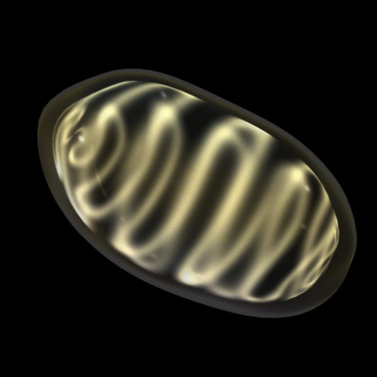
OKSIDATIVNA DEZAMINACIJA
Reakciju katalizuje glutamat dehidrogenaza
NH₃⁺
⁻OOC-CH₂-CH₂-CH-COO⁻
glutamat
NAD(P)⁺
NAD(P)H+H⁺
NH₄⁺
SINTEZA UREJE
O
⁻OOC-CH₂-CH₂-C-COO⁻
α ketoglutarat

Slide 3
NH₄⁺
HCO₃⁺
2 ATP
Karbamil fosfat
sintetaza I
2 ADP + Pi
O
O
=
=
H₂N-C-O-P-O⁻
O⁻
Karbamil fosfat
NH₃⁺
O
=
H₂N
-C-NH-(CH₂)₃-CH₂-CH-COO⁻
Ornitin
transkarbamilaza
Citrulin
Pi
NH₃⁺
Citrulin
H₃N⁺
-(CH₂)₃-CH₂-CH-COO⁻
Ornitin

Slide 4
NH₃⁺
NH₃⁺
O
⁻OOC-CH₂-CH-COO⁻
=
ATP
H₂N
-C-NH-(CH₂)₃-CH₂-CH-COO⁻
Aspartat
Citrulin
AMP + PiP
⁻OOC-CH₂-CH-COO⁻
Citrulin
NH
NH₃⁺
Karbamil
fosfat
H₂N
-C-NH-(CH₂)₃-CH₂-CH-COO⁻
Argininosukcinat
Ornitin
NH₃⁺
H₃N⁺
-(CH₂)₃-CH₂-CH-COO⁻
⁻OOC-CH
=
Ornitin
CH-COO⁻
⁺NH₂
NH₃⁺
Fumarat
=
H₂N
-C-NH-(CH₂)₃-CH₂-CH-COO⁻
H₂N-C-NH₂
Arginin
=
O
Urea
H₂O

Slide 5
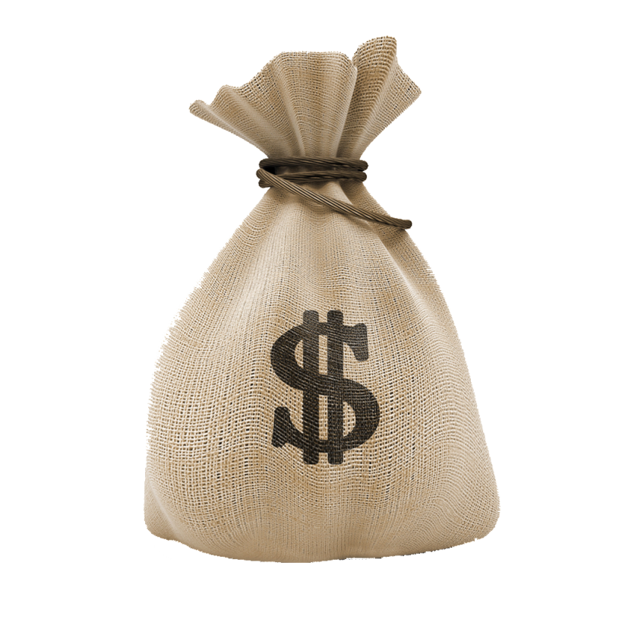
NH₃⁺
NH₃⁺
NH₄⁺
O
⁻OOC-CH₂-CH-COO⁻
=
ATP
H₂N
-C-NH-(CH₂)₃-CH₂-CH-COO⁻
Aspartat
HCO₃⁺
Citrulin
AMP + PiP
2 ATP
⁻OOC-CH₂-CH-COO⁻
Citrulin
2ADP + Pi
NH
NH₃⁺
Karbamil
fosfat
H₂N
-C-NH-(CH₂)₃-CH₂-CH-COO⁻
Argininosukcinat
Ornitin
NH₃⁺
H₃N⁺
-(CH₂)₃-CH₂-CH-COO⁻
⁻OOC-CH
=
Ornitin
CH-COO⁻
⁺NH₂
NH₃⁺
Fumarat
=
H₂N
-C-NH-(CH₂)₃-CH₂-CH-COO⁻
H₂N-C-NH₂
Arginin
=
O
Urea
H₂O

Slide 6
